Slide 1
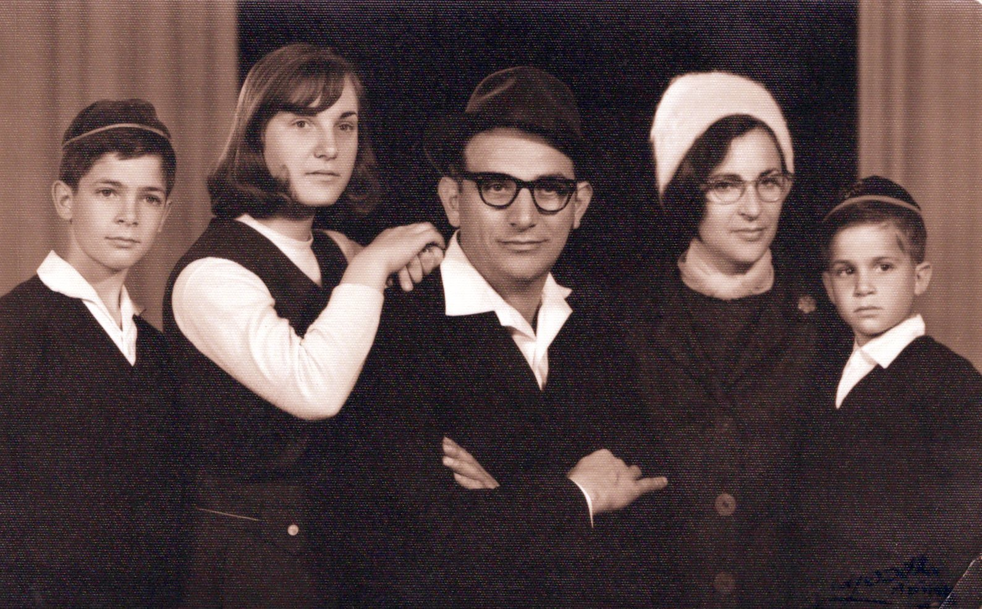
On how the past illuminates the future
Orna Kupferman
The Hebrew University

Slide 2
Automata!
1
0
q₀
q₁
1
0
A=⟨Σ,Q,q₀,𝛿,𝛼⟩
deterministic: 𝛿: Q × Σ → Q
Finite words: a run is accepting if it ends in a state in 𝛼
L(A) = {w : w ends with 1}

Slide 3
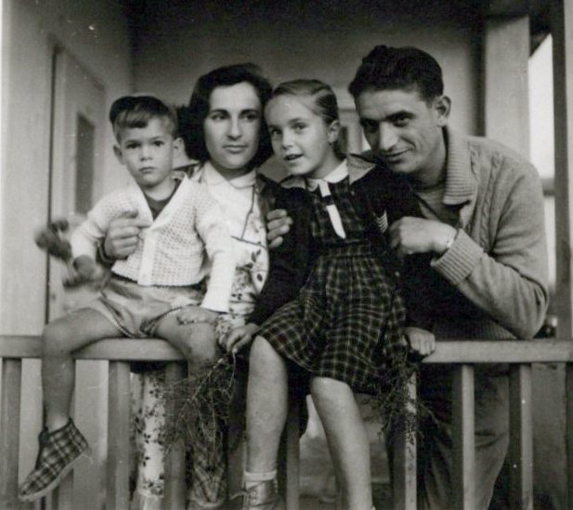
Rabin Scott 1959: Finite automata and their decision problems

Slide 4
Rabin Scott 1959: Finite automata and their decision problems

Slide 5
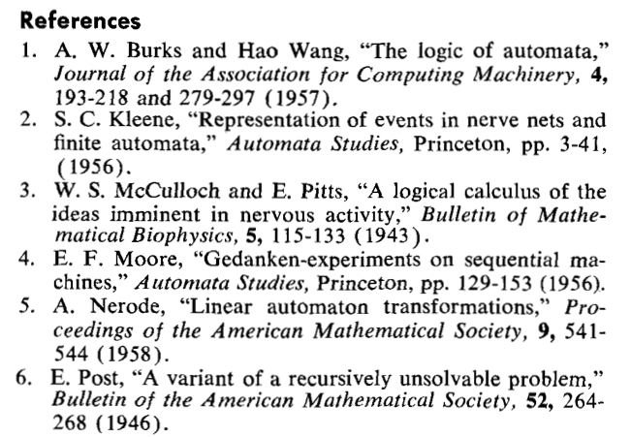
Rabin Scott 1959: Finite automata and their decision problems

Slide 6
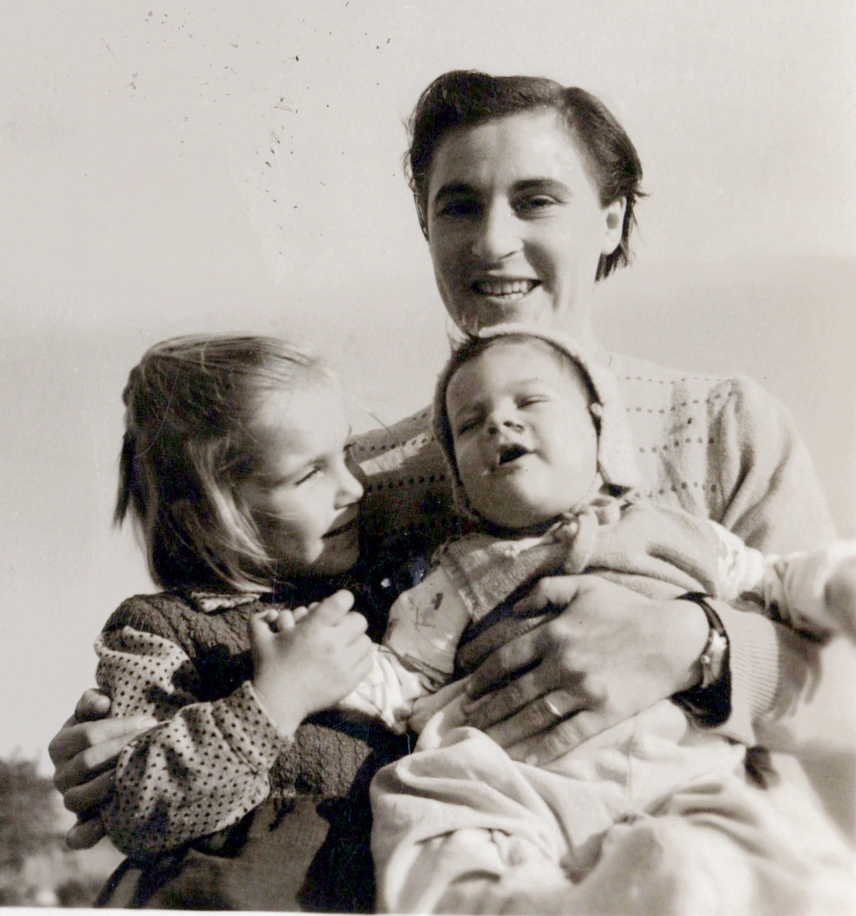
Rabin Scott 1959: Finite automata and their decision problems
1954

Slide 7
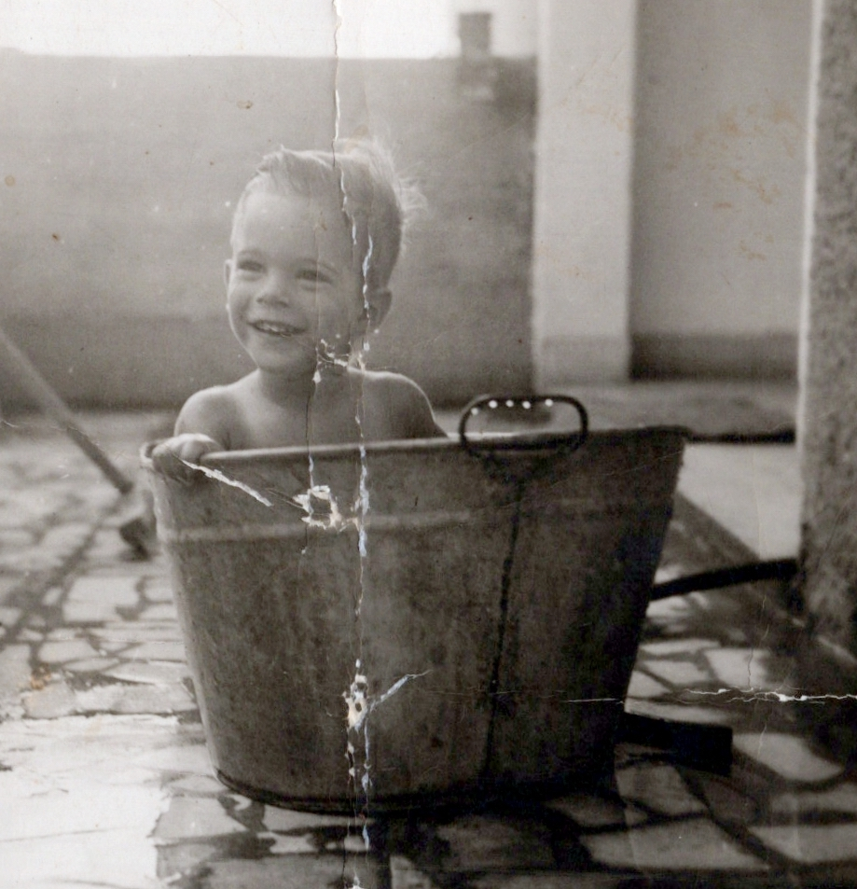
Rabin Scott 1959: Finite automata and their decision problems
1955

Slide 8
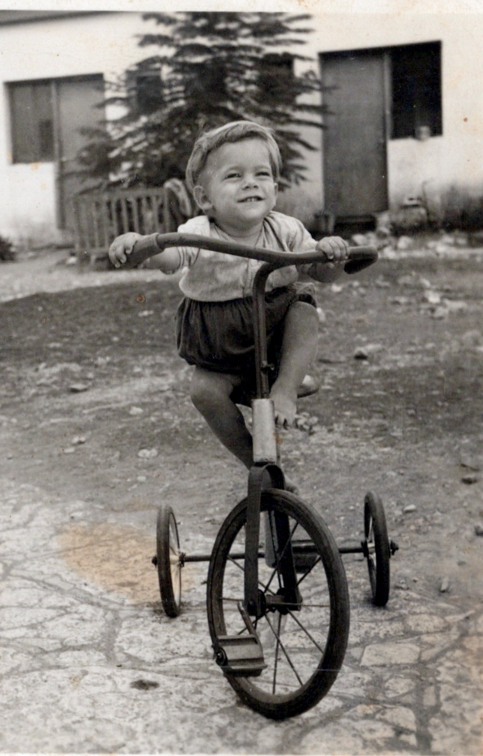
Rabin Scott 1959: Finite automata and their decision problems
1956

Slide 9
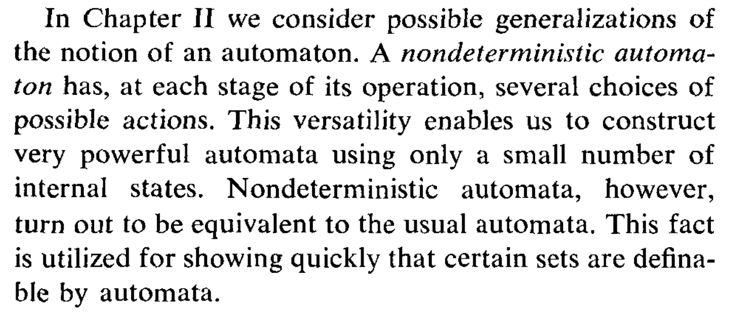
Rabin Scott 1959: Finite automata and their decision problems

Slide 10
Nondeterministic Automata
0,1
1
q₀
q₁
A=⟨Σ,Q,Q₀,𝛿,𝛼⟩
non-deterministic: 𝛿: Q × Σ → 2^{Q}
L(A) = {w : w ends with 1}

Slide 11
Rabin Scott 1959: Finite automata and their decision problems

Slide 12
Nondeterministic Automata
0,1
1
q₀
q₁
L(A_{n}) = {w : w ends with 1⋅(0+1)^{n}}
L(A) = {w : w ends with 1}

Slide 13
Nondeterministic Automata
0,1
1
0,1
0,1
0,1
0,1
q₀
q₁
q₂
q₃
...
q_{n+1}
L(A_{n}) = {w : w ends with 1⋅(0+1)^{n}}
An equivalent deterministic automaton: 2^{n} states.

Slide 14
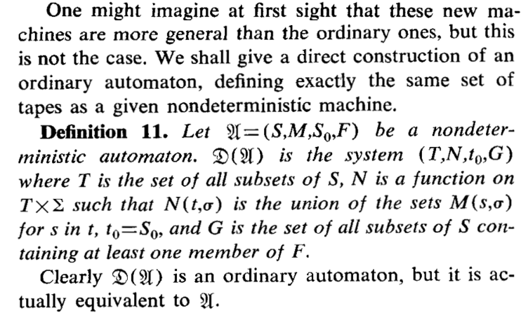
Rabin Scott 1959: Finite automata and their decision problems

Slide 15
Rabin Scott 1959: Finite automata and their decision problems
U →D(U)
U is in one of the states s₁,s₂,...,s_{k} after reading w
The subset construction
D(U) is in the state {s₁,s₂,...,s_{k}} after reading w

Slide 16
Finite words... easy!

Slide 17
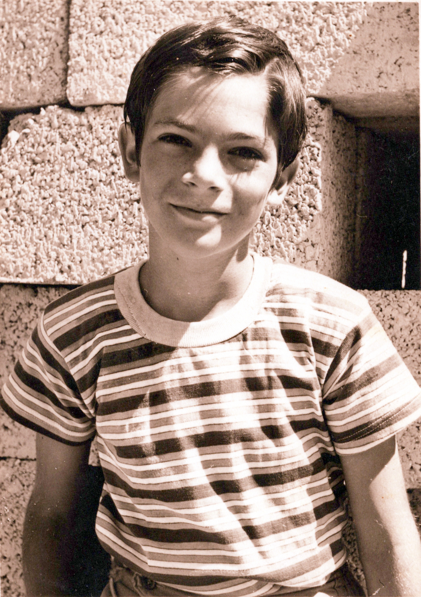
Finite words... easy!
Büchi 1962:
Automata on infinite words.

Slide 18
Büchi 1962: Automata on infinite words
A run is accepting if it visits states in 𝛼 infinitely often
1
0
q₀
q₁
1
0
L(A) = {w : w has infinitely many 1s}
Complementation...

Slide 19
Büchi 1962: Automata on infinite words
A run is accepting if it visits states in 𝛼 infinitely often
1
0
q₀
q₁
1
0
L(A) = {w : w has infinitely many 0s}

Slide 20
Büchi 1962: Automata on infinite words
A run is accepting if it visits states in 𝛼 infinitely often
0,1
0
0
q₀
q₁
L(A) = {w : w has finitely many 1s}
= (0+1)*⋅0^{𝜔}

Slide 21
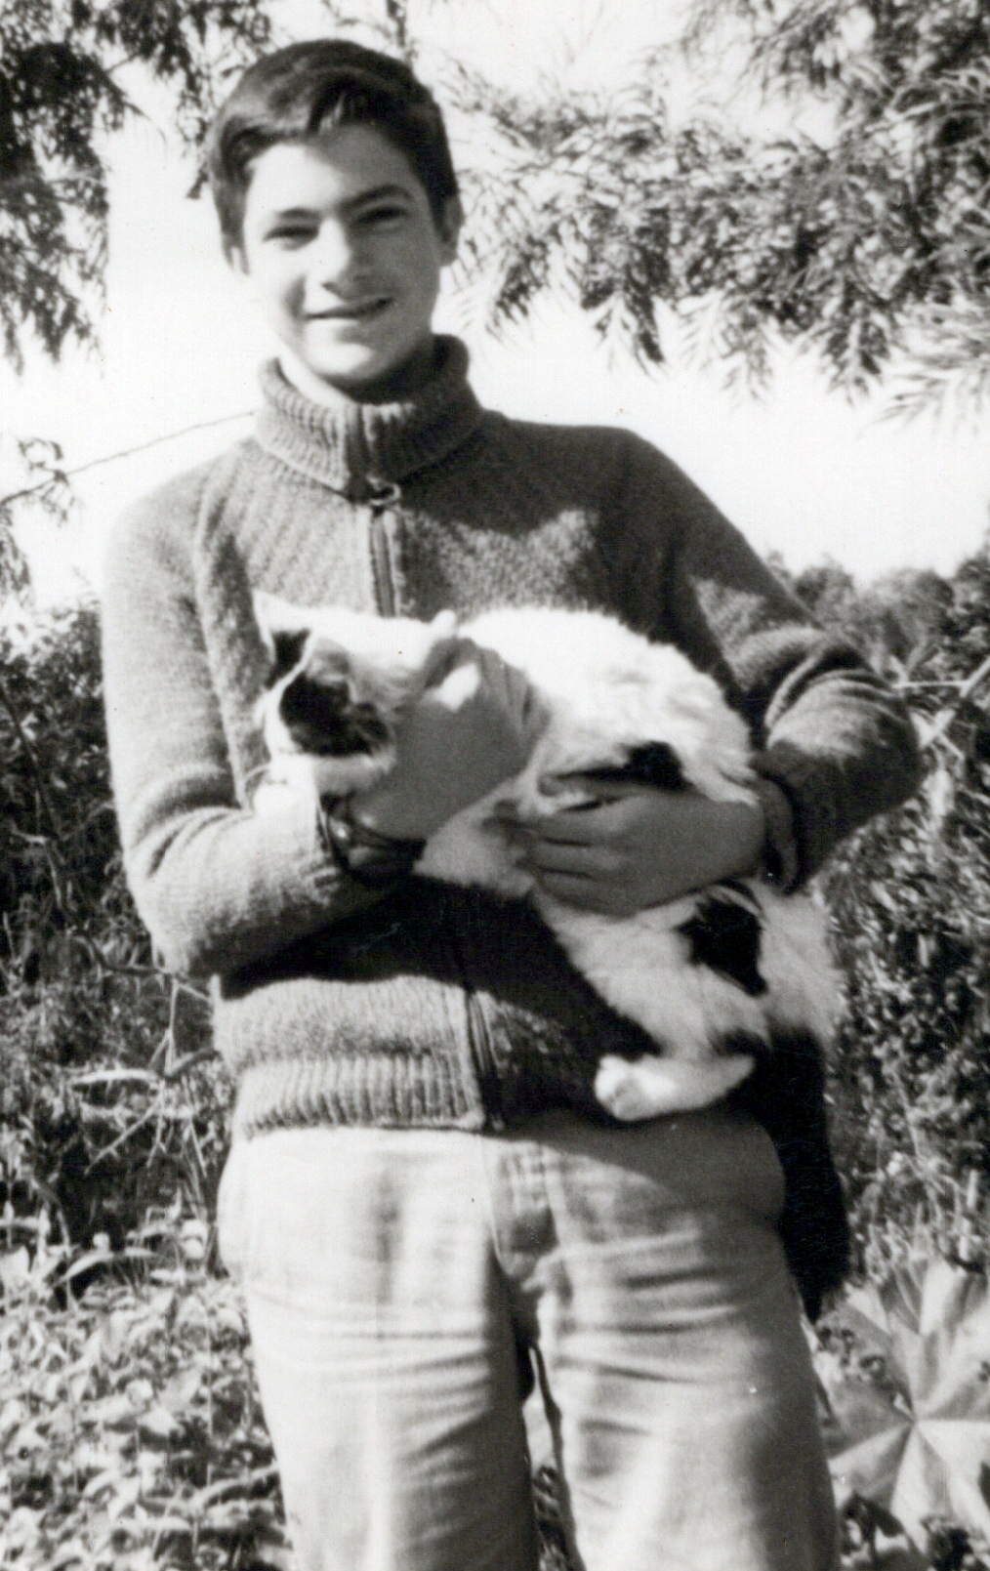
Büchi 1962: Automata on infinite words
A run is accepting if it visits states in 𝛼 infinitely often
0,1
0
0
q₀
q₁
L(A) = {w : w has finitely many 1s}
Landweber 1969: no deterministic Büchi automaton!

Slide 22
Büchi 1962: Automata on infinite words
A run is accepting if it visits states in 𝛼 infinitely often
0,1
0
0
q₀
q₁
L(A) = {w : w has finitely many 1s}
Landweber 1969: no deterministic Büchi automaton!

Slide 23
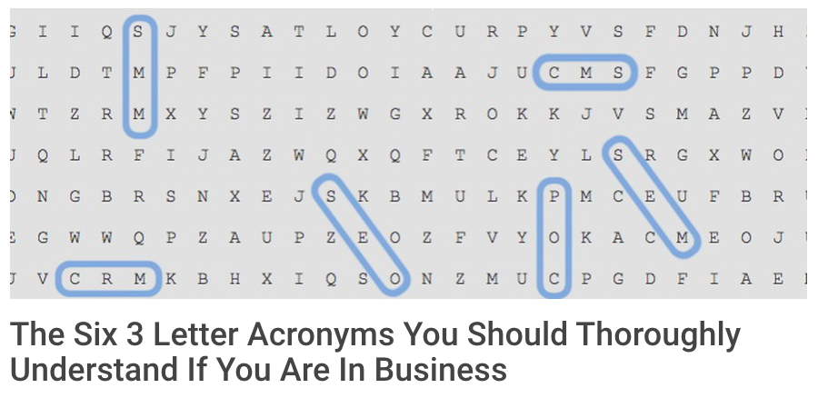
So, NFW = DFW, yet NBW > DBW
- Three letter acronyms in {D,N} × {F,B,C,R,P} × {W,T}
{N,D} branching mode (deterministic/nondeterministic)
{F,B,C,R,P} acceptance condition (finite/Büchi/co-Büchi/Rabin/parity)
{W,T} object to run on (words, trees)
automata

Slide 24
So, NFW = DFW, yet NBW > DBW
- Three letter acronyms in {N,D} × {F,B,C,R,P} × {W,T}
NFW: Nondeterministic Finite Word automata
DBW: Deterministic Büchi Word automata

Slide 25
Büchi 1962: Satisfiability of S1S ⟶ nonemptiness of NBWs.
S1S: Monadic second order logic with one successor
∀x∃y∃z. y=z+z ∧ y>x x,y,z ∊ ℕ
Every natural number has a bigger even number.
...
0
1
2
3
4
5
6
Büchi 1962: S1S formula 𝜑 → NBW for the models of 𝜑

Slide 26
The community 1962+: Do the same with SnS

Slide 27
The community 1962+: Do the same with SnS
SnS: Monadic second order logic with n successors
...
...
...
...
...
...
...
...
S2S: two successors

Slide 28
...
S1S: one successor
0
1
2
3
4
5
6
x ∊ ℕ
...
x ∊ 1*
𝜺
1
1²
1³
1⁴
1⁵
1⁶
...
2
S2S: two successors
...
...
...
x ∊ {1,2}*
...
𝜀
121
...
1
...
11

Slide 29
SnS: Monadic second order logic with n successors
Every non-root node in the tree {1,2}* has a single parent
∀x (x≠𝜀) → ∃y (x=y.1 ∨ x=y.2) ∧ ∀z. (z≠y) → (x≠z.1 ∧ x≠z.2)
x,y,z ∊ {1,2}*
The community 1962+: let’s reduce SnS ⟶ NBT
NBT: Nondeterministic Büchi Tree automata

Slide 30
Tree automata:
𝛿(q₀,a)={⟨q₁,q₂⟩,⟨q₃,q₄⟩}
q₀
a
q₁
q₂
...
...
...
...

Slide 31
Tree automata:
𝛿(q₀,a)={⟨q₁,q₂⟩,⟨q₃,q₄⟩}
q₀
a
q₃
q₄
...
...
...
...
a run is accepting if it visits states in 𝛼 infinitely often in all paths

Slide 32
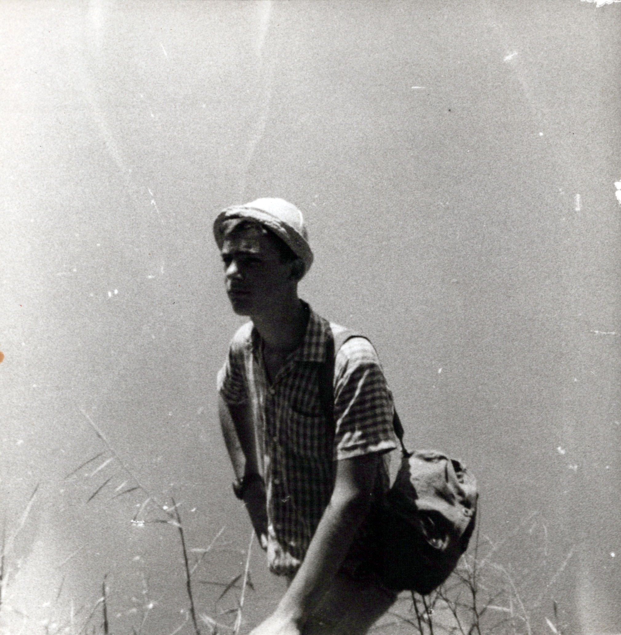
Rabin 1969:

Slide 33
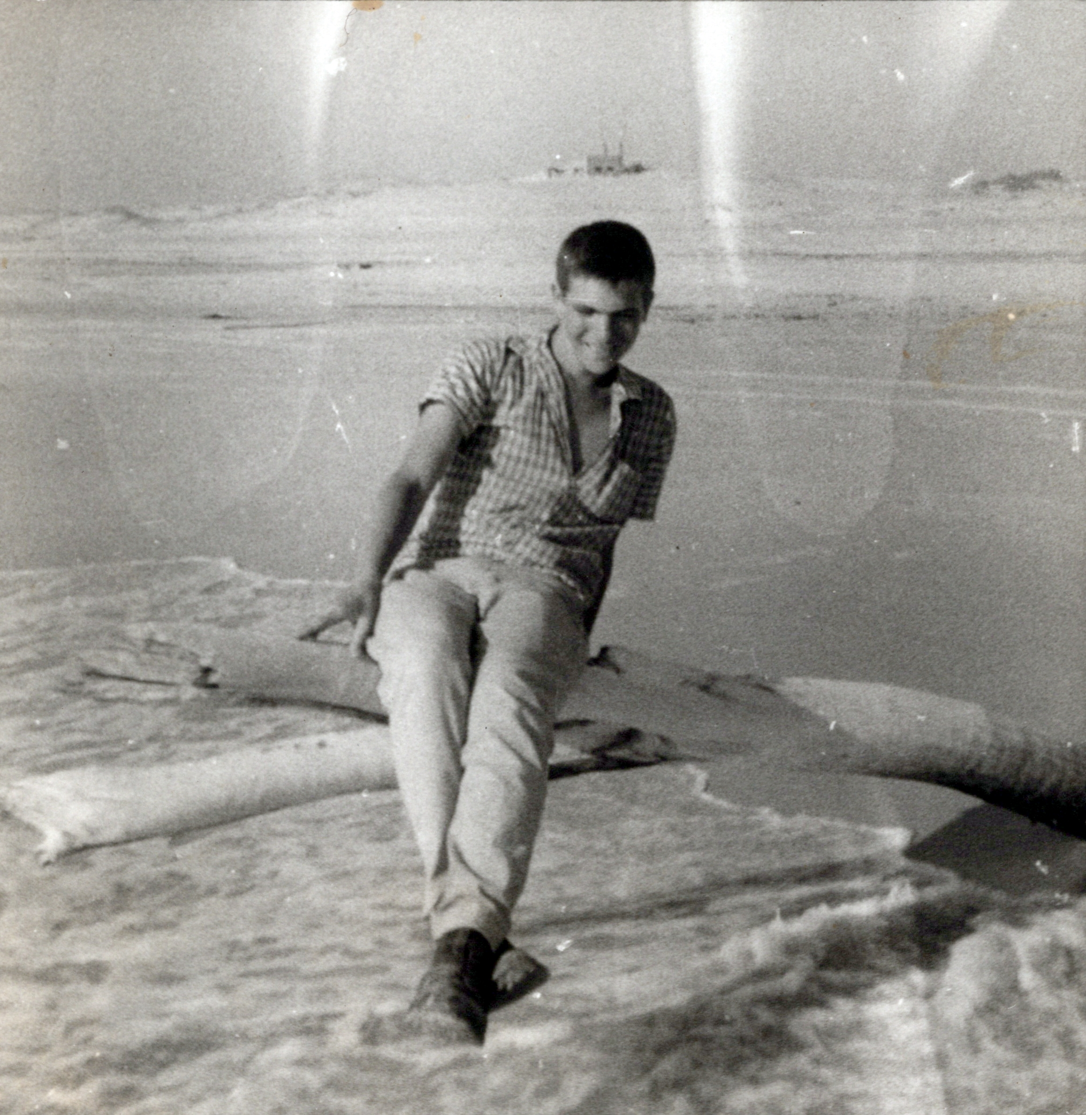
Rabin 1969: Satisfiability of SnS ⟶ nonemptiness of NRTs.
NRT: Nondeterministic Rabin Tree automata
A stronger acceptance condition
Rabin 1971:

Slide 34
Rabin 1969: Satisfiability of SnS ⟶ nonemptiness of NRTs.
NRT: Nondeterministic Rabin Tree automata
A stronger acceptance condition
Rabin 1971:
NRT > NBT
No reduction SnS ⟶ NBT
(and I knew it since 1968)

Slide 35
So, Rabin 1971: NRT > NBT
Witness: in all paths of the tree, only finitely many 1’s.
Proof: very complicated.
Note: this is L∆, for L={w: w has only finitely many 1’s}
L ⊆Σ^{𝜔} L∆ : Σ-labeled trees all whose paths are in L

Slide 36
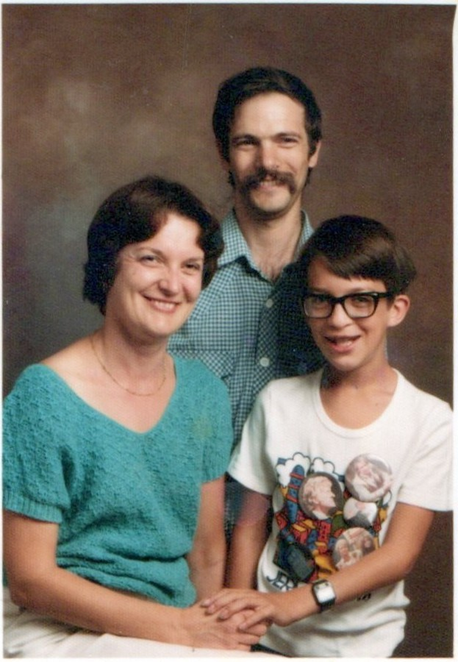
25 years later... (after Rabin 1971)
Note (15 years later):
Vardi Wolper 1986:

Slide 37
25 years later... (after Rabin 1971)
Note (15 years later):
Vardi Wolper 1986: A single-exponential translation LTL ⟶ NBW 👏👏👏👏
The translation S1S ⟶ NBW is non-elementary

Slide 38
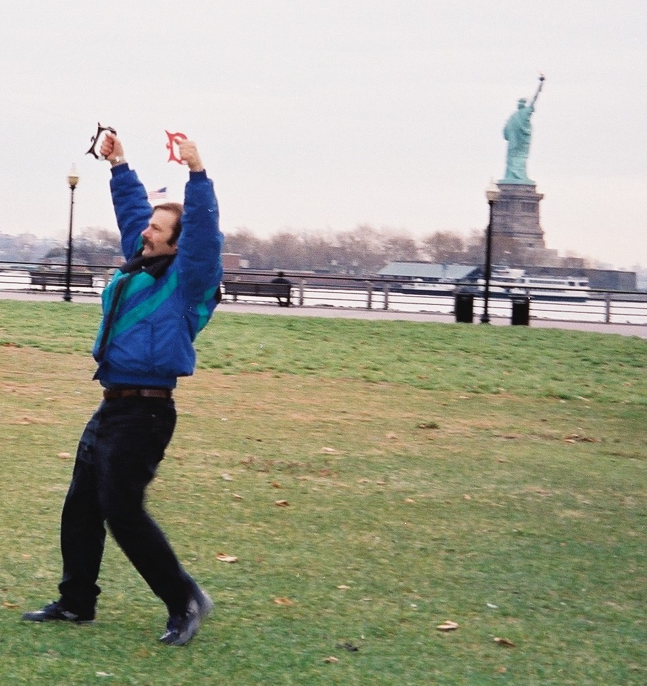
25 years later... 1996:
Kite Flying, Basic Safety Rules:

Slide 39
25 years later... 1996:
Kite Flying, Basic Safety Rules:
Be aware of the limitations of your skills and strength and do not fly anything too large for the conditions.
Never lift your hands above your head.

Slide 40
25 years later... 1996:
Kite Flying, Basic Safety Rules:
Be aware of the limitations of your skills and strength and do not fly anything too large for the conditions.
Never lift your hands above your head.

Slide 41
Kupferman Safra Vardi 1996:
A reminder:
L = {w : w has finitely many 1s}
Landweber 69: no DBW for L
Rabin 71: no NBT for L∆
KSV96: Rabin’s choice of L∆ was not coincidental

Slide 42
KSV1996: L∈NBW∖DBW iff L∆∈NRT∖NBT
Hard direction: L∆ in NBT ⟶ L in DBW
Intuition: a nondeterministic tree automaton for an L∆ language cannot really guess

Slide 43
Intuition: a nondeterministic tree automaton for an L∆ language cannot really guess
𝛿(q₈,a)={⟨q₁,q₂⟩,⟨q₃,q₄⟩}
q₈
q₃
a

Slide 44
Intuition: a nondeterministic tree automaton for an L∆ language cannot really guess.
𝛿(q₈,a)={⟨q₁,q₂⟩,⟨q₃,q₄⟩}
- The guess to proceed with q₃ should work for both w₁ and w₂
q₈
q₃
- So a deterministic word automaton for L can have 𝛿(q₈,a)=q₃
w₁
w₂
- almost...

Slide 45
Intuition: a nondeterministic tree automaton for an L∆ language cannot really guess.
𝛿(q₈,a)={⟨q₁,q₂⟩,⟨q₃,q₄⟩}
- The guess to proceed with q₃ should work for both w₁ and w₂
q₈
q₈
q₃
q₁
- So a deterministic word automaton for L can have 𝛿(q₈,a)=q₃
w₁
w₂
- almost... perhaps 𝛿(q₈,a)=q₁ ?

Slide 46
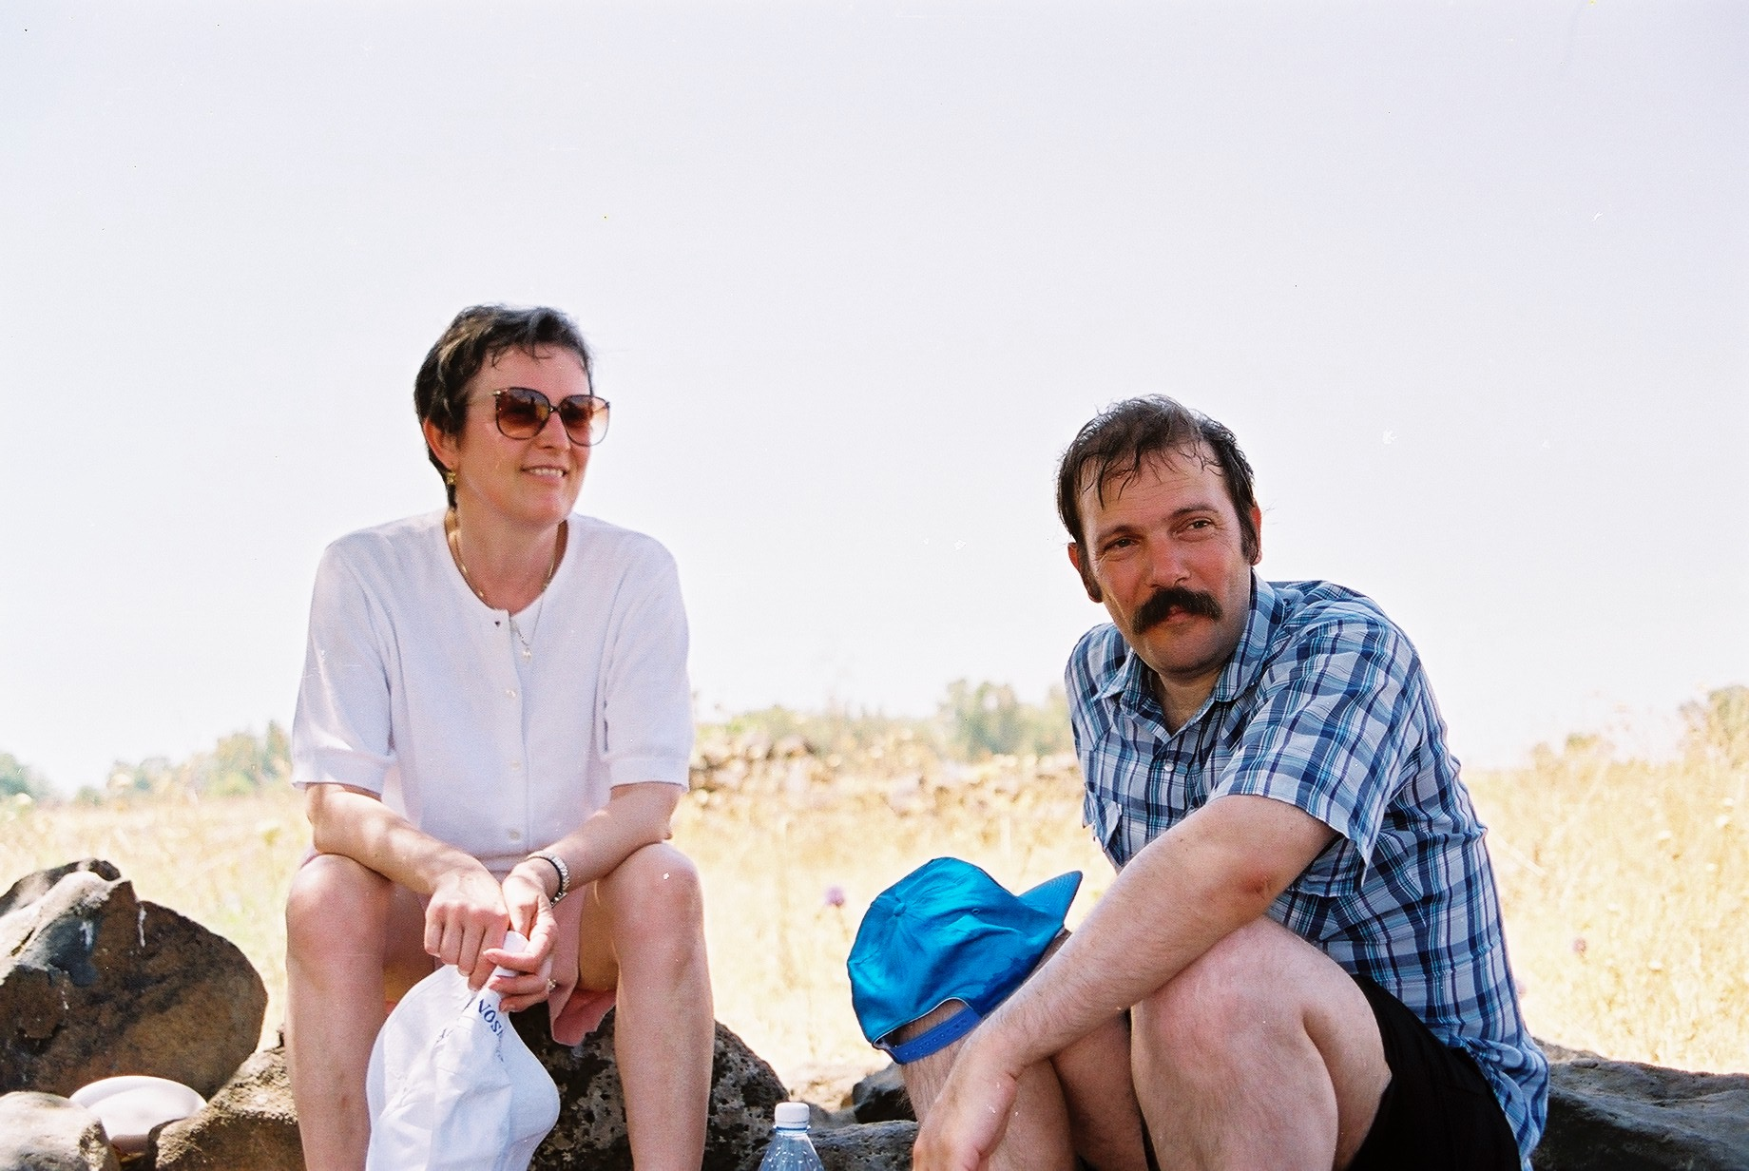
Kupferman Safra Vardi 1996:
NBT for L∆ with state space Q ⟶ DBW for L with state space 2^{Q}
(almost the subset construction).
Niwinski Walukiewicz 1998:

Slide 47
Kupferman Safra Vardi 1996:
NBT for L∆ with state space Q ⟶ DBW for L with state space 2^{Q}
(almost the subset construction).
Niwinski Walukiewicz 1998:
NXT for L∆ ⟶ DXW for L
- No extra expressive power
- What about succinctness?

Slide 48
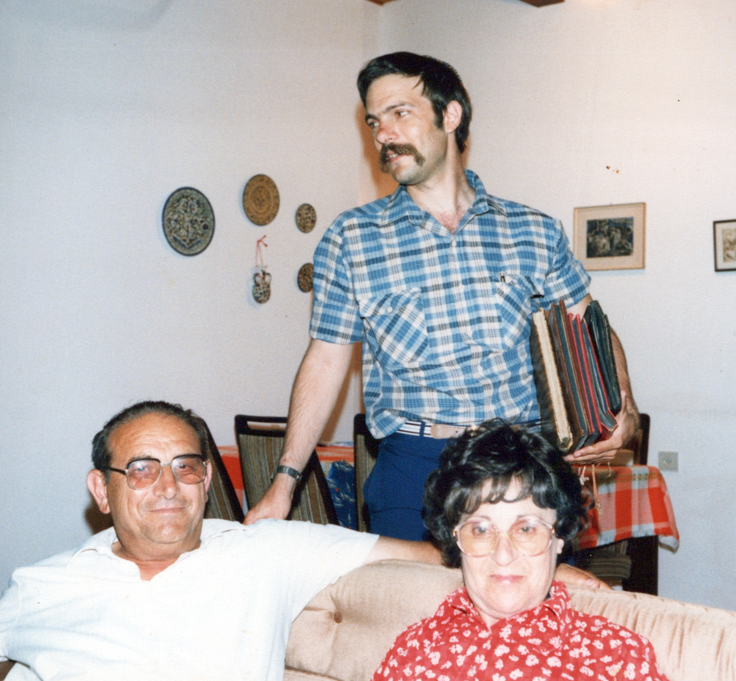
2000+: shift: tree automata ⟶ games

Slide 49
2000+: Shift: tree automata ⟶ games
Main application: synthesis of reactive systems [Pnueli Rozner 1988]
A specification L ⊆(2^{I∪O})^{𝜔}
Story 1: label by letters in 2^{O} a tree with directions in 2^{I}: branches correspond to inputs, labels to outputs ⟶ nonemtiness of a tree automaton for L∆
Story 2: find a winning strategy in a game played on a deterministic automaton for L: environment chooses actions in 2^{I}, system responds with actions in 2^{I} ⟶ game solving

Slide 50
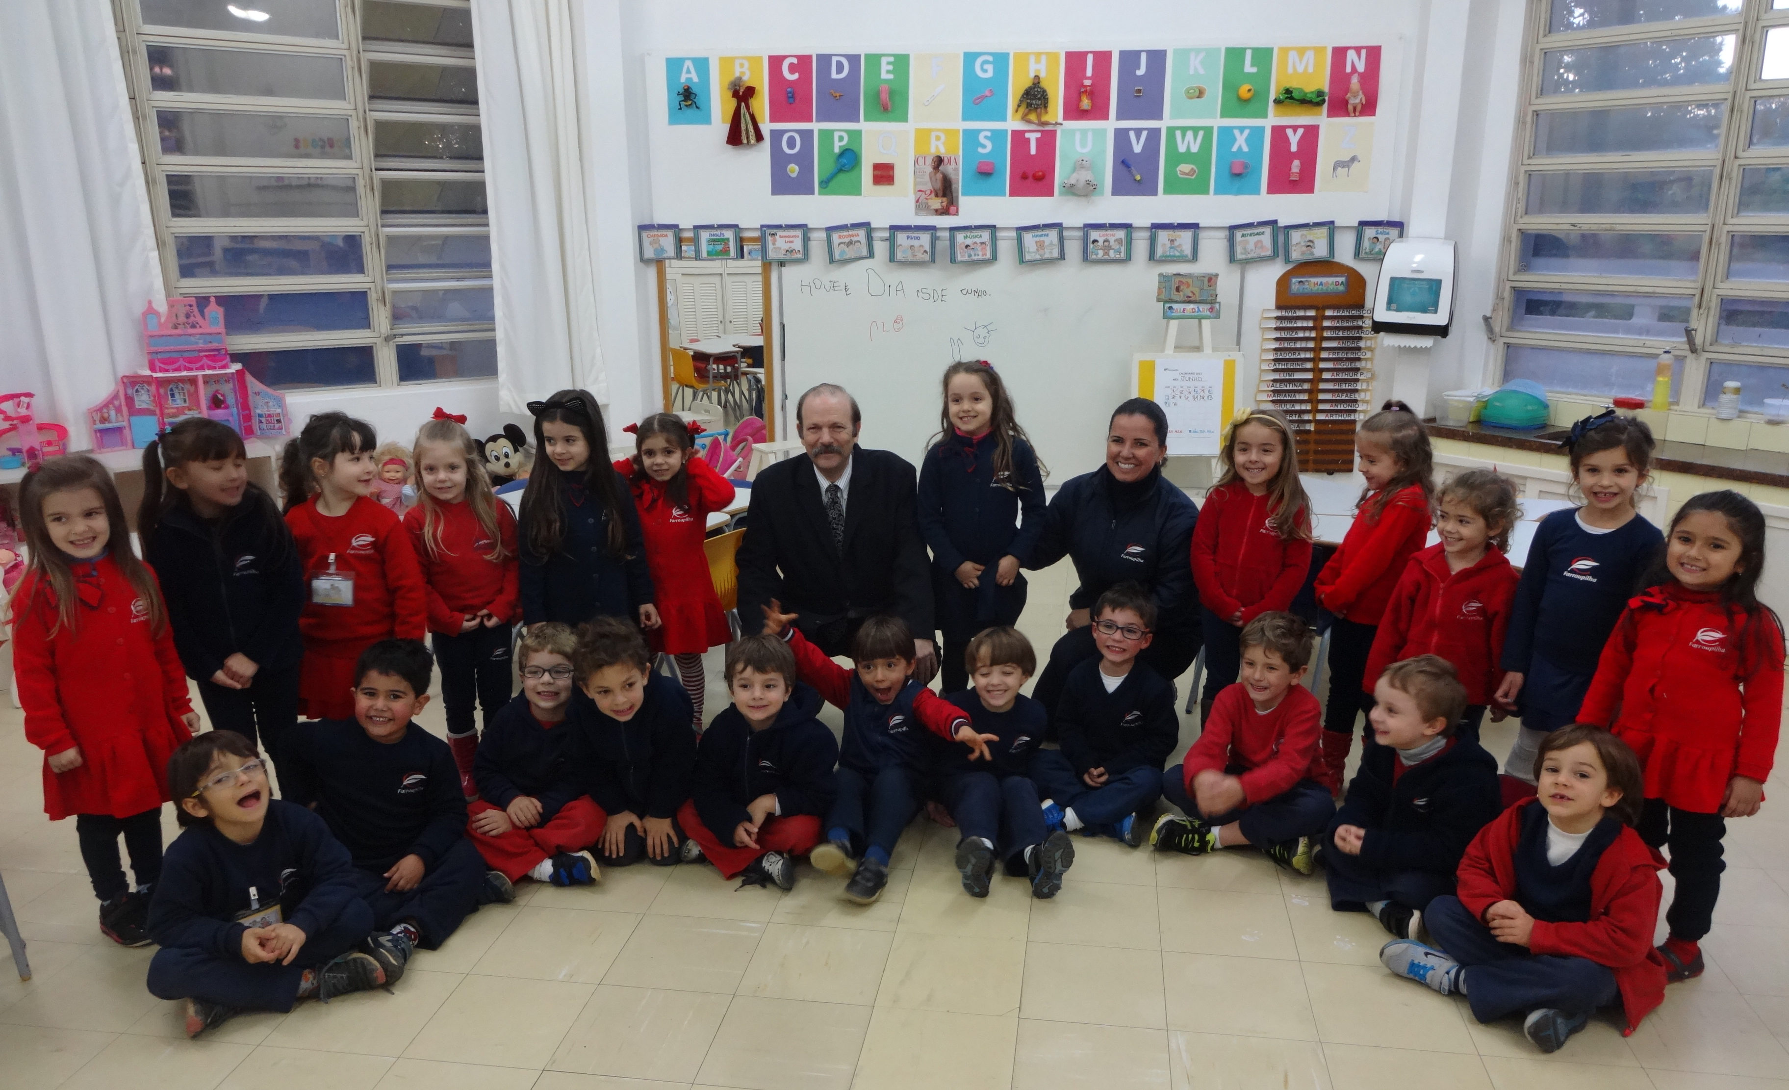
Henzinger Piterman 2006: good for games (GFG) automata

Slide 51
Henzinger Piterman 2006: good for games (GFG) automata
Intuitively: good for games
Formally: A=⟨Σ,Q,Q₀,𝛿,𝛼⟩ is GFG if there is f: Σ* → Q such that
- f(𝜀)∈Q₀
- for all w∈Σ* and 𝜎∈Σ, we have that f(w⋅𝜎)∈𝛿(f(w),𝜎)
- for all w∈Σ^{𝜔}, if w∈L(A), then f(w) is accepting
f(w)=f(𝜀).f(𝜎₁).f(𝜎₁𝜎₂). f(𝜎₁𝜎₂𝜎₃)....
Resolves nondeterminism in a way that only depends on the past

Slide 52
Resolves nondeterminism in a way that only depends on the past.
𝛿(q₈,a)={q₁,q₃,q₄}
f(w₁⋅a)=q₃
w₁
a
q₈
q₃
q₃
Σ-tree

Slide 53
Resolves nondeterminism in a way that only depends on the past.
𝛿(q₈,a)={q₁,q₃,q₄}
f(w₁⋅a)=q₃
f(w₂⋅a)=q₁
w₁
a
w₂
q₈
q₈
a
q₁
q₁
Σ-tree

Slide 54
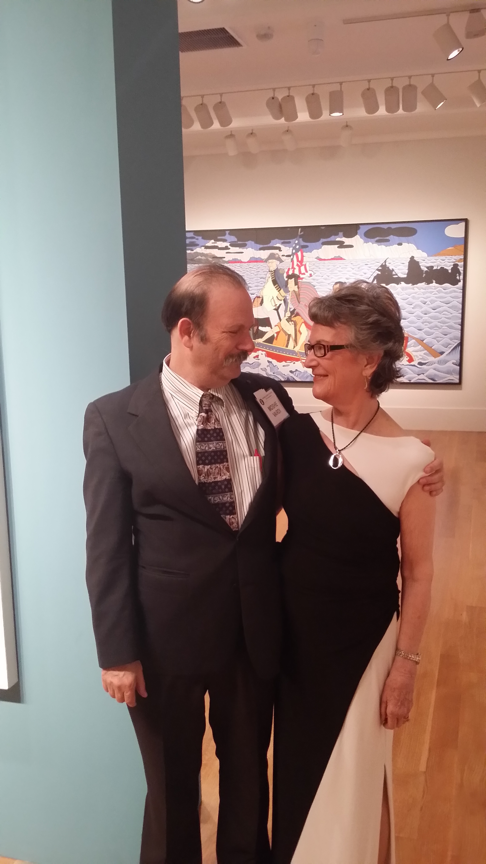
Boker Kuperberg Kupferman Skrzypczak 2013:

Slide 55
Boker Kuperberg Kupferman Skrzypczak 2013: GFG-NXW for L = NXT for L∆
w₁
q₈
a
w₂
q₈
q₈
q₃
q₈
a
q₃
q₁
q₁
w₁
w₂
GFG: Σ-tree, accepting runs in branches in L
tree in L∆: accepting runs in all branches

Slide 56
Example: A GFG-NFW
0,1
0
0,1
0
1
0
q₀
q₁
q₂
q₃
1
L(A) = {w : w contains 010}

Slide 57
Example: A GFG-NFW
0,1
0
0,1
0
1
0
q₀
q₁
q₂
q₃
1
L(A) = {w : w contains 010}

Slide 58
Example: A GFG-NFW
0,1
0
0,1
0
1
0
q₀
q₁
q₂
q₃
1
L(A) = {w : w contains 010}

Slide 59
Example: A GFG-NFW
0,1
0
0,1
0
1
0
q₀
q₁
q₂
q₃
1
L(A) = {w : w contains 010}
Every DBP automaton is GFG:
f(w)=𝛿(f(𝜀),w)
DBP: determinizable by pruning

Slide 60
Are there GFG automata that are not DBP?
HP06: NBW ⟶ GFG-NPW, which is DBP
Finite words: No (all GFG-NFWs are DBP)
Proof: Easy
Infinite words: Yes!

Slide 61
BKKS 2013: GFG automata need not be DBP!
1
A is a tNBW
1
#
#
L(A)⊆(#0+#1)^{𝜔}
0
0
traversing an 𝛼-transition
reading #0#0 or #1#1
1
1
#
0
#
0
L(A)= {w∈(#0+#1)^{𝜔} : w has infinitely many #0#0 or #1#1 }

Slide 62
BKKS 2013: GFG automata need not be DBP!
1
Not DBP:
1
#
#
0
0
1
1
#
0
#
0
L(A)= {w∈(#0+#1)^{𝜔} : w has infinitely many #0#0 or #1#1 }

Slide 63
BKKS 2013: GFG automata need not be DBP!
1
Not DBP:
1
#
Pruning 1: rejects (#1)^{𝜔}
0
0
1
1
#
0
#
0
L(A)= {w∈(#0+#1)^{𝜔} : w has infinitely many #0#0 or #1#1 }

Slide 64
BKKS 2013: GFG automata need not be DBP!
1
Not DBP:
1
#
#
Pruning 1: rejects (#1)^{𝜔}
0
0
Pruning 2: rejects (#0)^{𝜔}
1
1
0
#
0
L(A)= {w∈(#0+#1)^{𝜔} : w has infinitely many #0#0 or #1#1 }

Slide 65
BKKS 2013: GFG automata need not be DBP!
1
GFG strategy in q₀:
- if you arrive with 1, go up
- if you arrive with 0, go down
1
#
#
0
0
1
1
#
0
#
0
L(A)= {w∈(#0+#1)^{𝜔} : w has infinitely many #0#0 or #1#1 }

Slide 66
So, GFG automata need not be DBP!
Can GFG automata be smaller than deterministic ones?
The previous example does not imply this:
⟺
1
1
#
1
#
#
almost subset construction
1
0
0
#
0
1
1
1
0
#
0
#
#
0
0

Slide 67
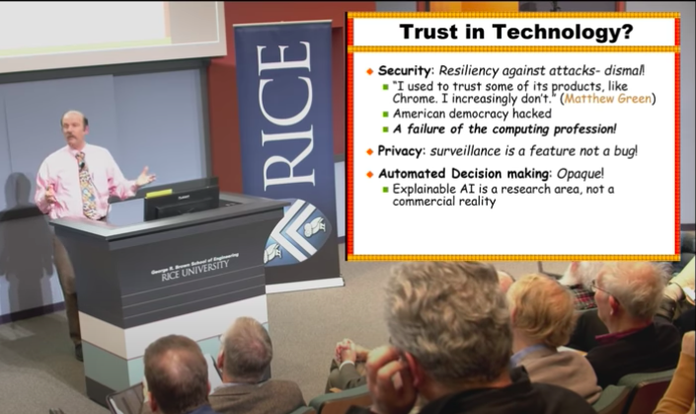
So, GFG automata need not be DBP!
Can GFG automata be smaller than deterministic ones?
Finite words: No (all GFG-NFWs are DBP)
Infinite words:
Hint: Moshe is busy lecturing about ethical crises in computing

Slide 68
So, GFG automata need not be DBP!
Can GFG automata be smaller than deterministic ones?
Finite words: No (all GFG-NFWs are DBP)
Infinite words: Open!
Hint: Moshe is busy lecturing about ethical crises in computing
with all due respect to ethical crises in computing...

Slide 69
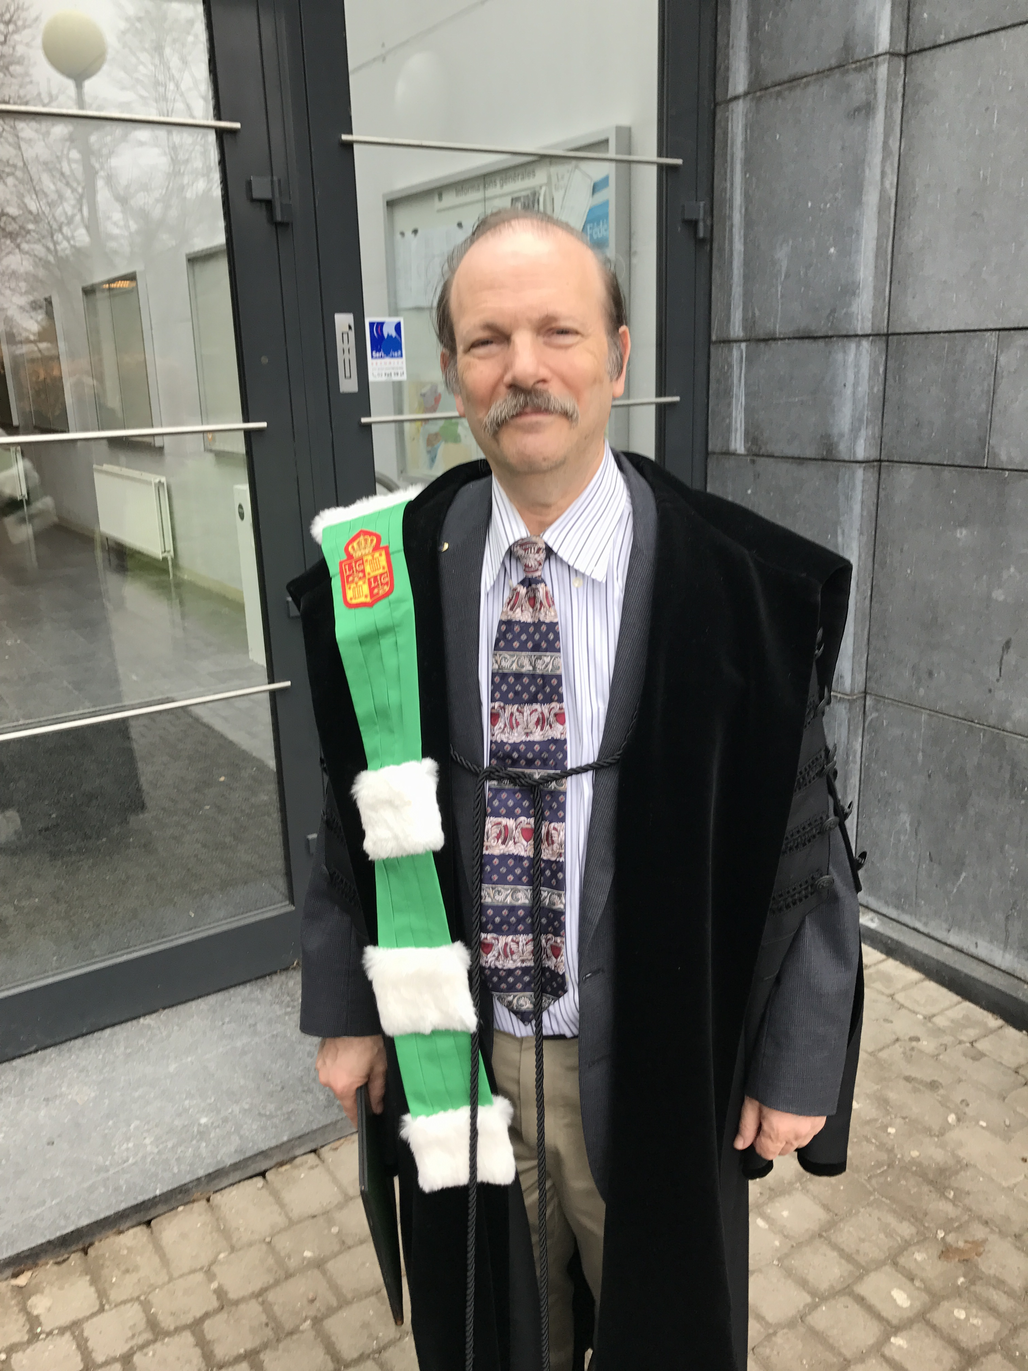
So, GFG automata need not be DBP!
Can GFG automata be smaller than deterministic ones?
Finite words: No (all GFG-NFWs are DBP)
Can you show me the solution for co-Büchi?
Infinite words: Open!
Kuperberg, Skrzypczak 2016:
- Solution for co-Büchi automata
- Still open for Büchi

Slide 70
Kuperberg, Skrzypczak 2016:
GFG-NCW are exponentially more succinct than DCW!
😱😱
NCW: nondeterministic co-Büchi word automata
A run is accepting if it visits states in 𝛼 only finitely often

Slide 71
Kuperberg, Skrzypczak 2016:
GFG-NCW are exponentially more succinct than DCW!
😱😱
A family of languages L₁,L₂,L₃,... such that for every n≥1:
- L_{n} can be recognized by a GFG-NCW with n states
- A minimal DCW for L_{n} needs 2^{n} states
NCW: nondeterministic co-Büchi word automata
A run is accepting if it visits states in 𝛼 only finitely often

Slide 72
The language L_{n}:
n=5
0
1
2
3
4
...
n
...
∞

Slide 73
The language L_{n}:
n=5
0
1
2
3
4
...

Slide 74
I Z I H Z X I Z H X Z Z H ...
0
1
2
3
4
...
Four letters:
I
Z
X
H
0
1
2
3
...
n-1

Slide 75
The language L_{n}:
0
1
2
3
4
...
Σ = {I,Z,X,H}
L_{n} = {w: the graph induced by w contains an infinite line}

Slide 76
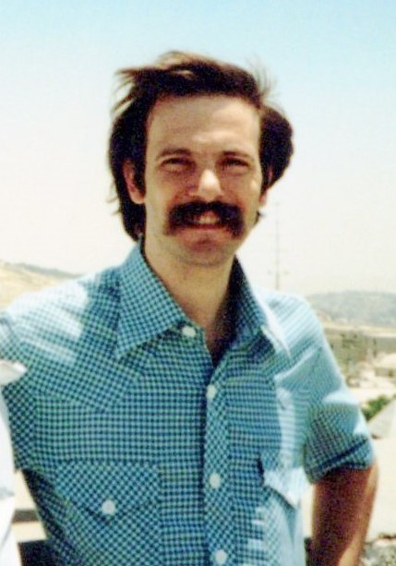
A DCW for L_{n}:
S
S ⊆{0,1,2,...,n-1}
S: the set of lines that survive since the previous break-point
Vardi Wolper 1986:
handling of eventualities

Slide 77
A DCW for L_{n}:
S
S ⊆{0,1,2,...,n-1}
H
I
S∖{0}
S: the set of lines that survive since the previous break-point
I
Z
X
H
0
1
2
3

Slide 78
H
{0,1,2}
{1,2}
A tDCW for L₄:
Z
I,X
H
H
{0,1,2,3}
{1,2,3}
{0}
I,H
X
I,Z,X
{0,2,3}
I
Z
X
H
I
0
1
2
3
2^{n}-1 states...

Slide 79
A tNCW for L_{n}: guesses a line that survives
Q ={0,1,2,...,n-1}

Slide 80
A tNCW for L_{n}: guesses a line that survives
Q ={0,1,2,...,n-1}
I,H
I
X
If you follow line 0 and read H,
take an 𝛼-transition to a new line
1
0
X,Z
Z
Z
Z
2
3
I
Z
X
H
0
1
2
3
I,X,H
I,X,H

Slide 81
A tNCW for L_{n}: guesses a line that survives
Q ={0,1,2,...,n-1}
I,H
I
H
X
If you follow line 0 and read H,
take an 𝛼-transition to a new line
1
0
X,Z
H
Z
H
H
Easy: correct
Hard: GFG
Z
Z
2
3
I
Z
X
H
0
1
2
3
I,X,H
I,X,H

Slide 82
A GFG strategy:
I Z I H Z X I Z H X Z Z H ...
0
1
2
3
4
...

Slide 83
A GFG strategy:
I Z I H Z X I Z H X Z Z H ...
0
1
2
3
4
...
- Suppose we start with 4..

Slide 84
A GFG strategy:
I Z I H Z X I Z H X Z Z H ...
0
1
2
3
4
...
4 4 0 0 ?
- Suppose we start with 4..
- Where to go?
- GFG strategy: To a line with a longest history!
- The idea: If an infinite line exists, it would eventually become a line with a longest history!

Slide 85
A GFG strategy:
I Z I H Z X I Z H X Z Z H ...
0
1
2
3
4
...
4 4 0 0 ?
- Suppose we start with 4..
- Where to go?
- Suppose we continue with 3...

Slide 86
A GFG strategy:
I Z I H Z X I Z H X Z Z H ...
0
1
2
3
4
...
4 4 0 0 3
4 4 4 0 ?
- Suppose we start with 4..
- Where to go?
- Suppose we continue with 3...
- Where to go?

Slide 87
A GFG strategy:
I Z I H Z X I Z H X Z Z H ...
0
1
2
3
4
...
4 4 0 0 3
4 4 4 0 ?
- Suppose we start with 4..
- Where to go?
- Suppose we continue with 3...
- Where to go?
- Not to 1

Slide 88
A GFG strategy:
I Z I H Z X I Z H X Z Z H ...
0
1
2
3
4
...
4 4 0 0 3
4 4 4 0 ?
- Suppose we start with 4..
- Where to go?
- Suppose we continue with 3...

Slide 89
A GFG strategy:
I Z I H Z X I Z H X Z Z H ...
0
1
2
3
4
...
4 4 0 0 3
4 4 4 0 ?
- Suppose we start with 4..
- Where to go?
- Suppose we continue with 3...
- Where to go?
- Possibly to 1

Slide 90
A GFG strategy:
I Z I H Z X I Z H X Z Z H ...
0
1
2
3
4
...
- Suppose we start with 4..
- Where to go?
- To a line with the longest history!
- Suppose we continue with 3..
- Where to go?
- Possibly to 1

Slide 91
A GFG strategy:
Kuperberg, Skrzypczak 2016
I Z I H Z X I Z H X Z Z H ...
0
1
2
3
4
...
- Indeed, if an infinite line exists, it would eventually become a line with a longest history!
- The past directed us how to resolve nondeterminism!
😱😱
- Exponential saving in co-Büchi automata
- Büchi: open!

Slide 92
Many more open GFG problems:
- Minimization of GFG automata (NP-complete for DBW and DCW, polynomial for GFG-tNCW)
- (I/O)-aware GFG automata (GFG in the input component of the alphabet, nondeterministic in the output component)
- Richer models (Alternating, pushdown, weighted... GFG-automata)
- Good-for-X automata (other applications in which current methods use deterministic automata, e.g., probabilistic reasoning)
- Additional models of weak-determinism (DBP, semantically deterministic, ...)

Slide 93
Thank you!

